Slide 1

MLibrary (Movie Library Application)

Slide 2
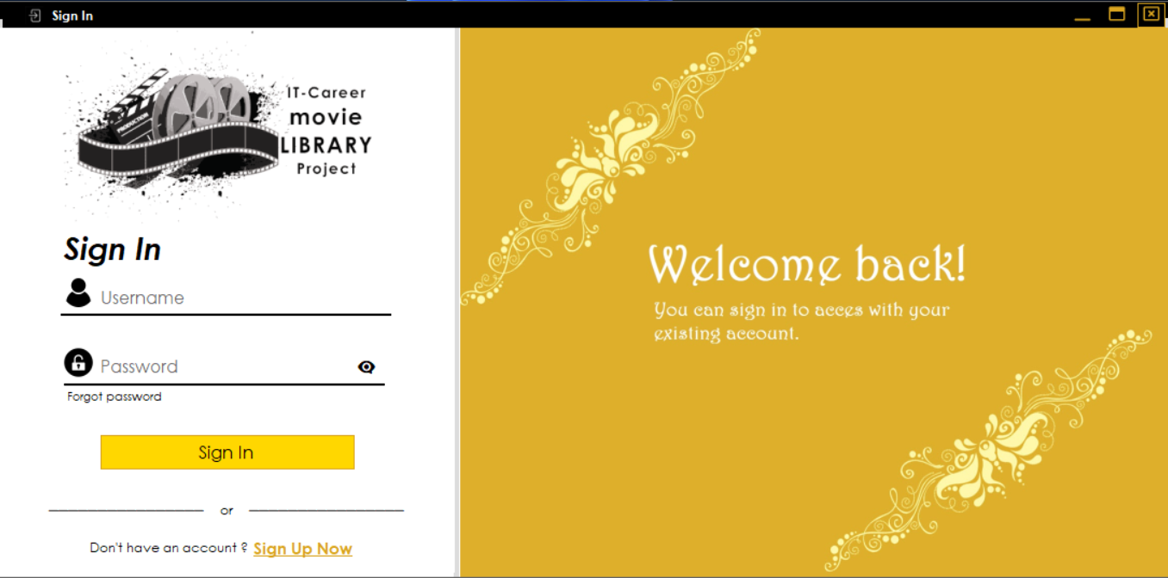
1.Login Page
-Username field.
-Password field.
-Hide/Unhide password.
-Forgot Password.
-Create New Account.
-Exceptions(Red borders).

Slide 3
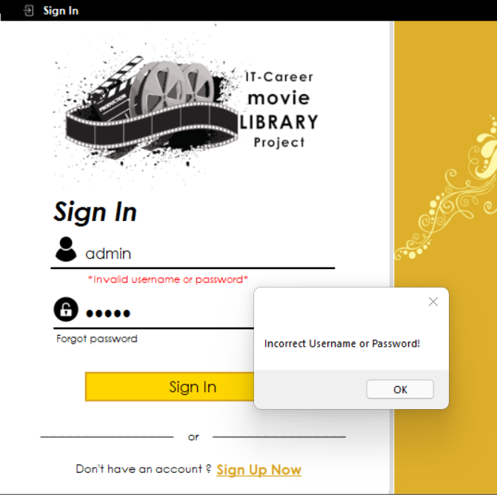
Login Page Exceptions
-Incorrect Username or Password! Exception

Slide 4
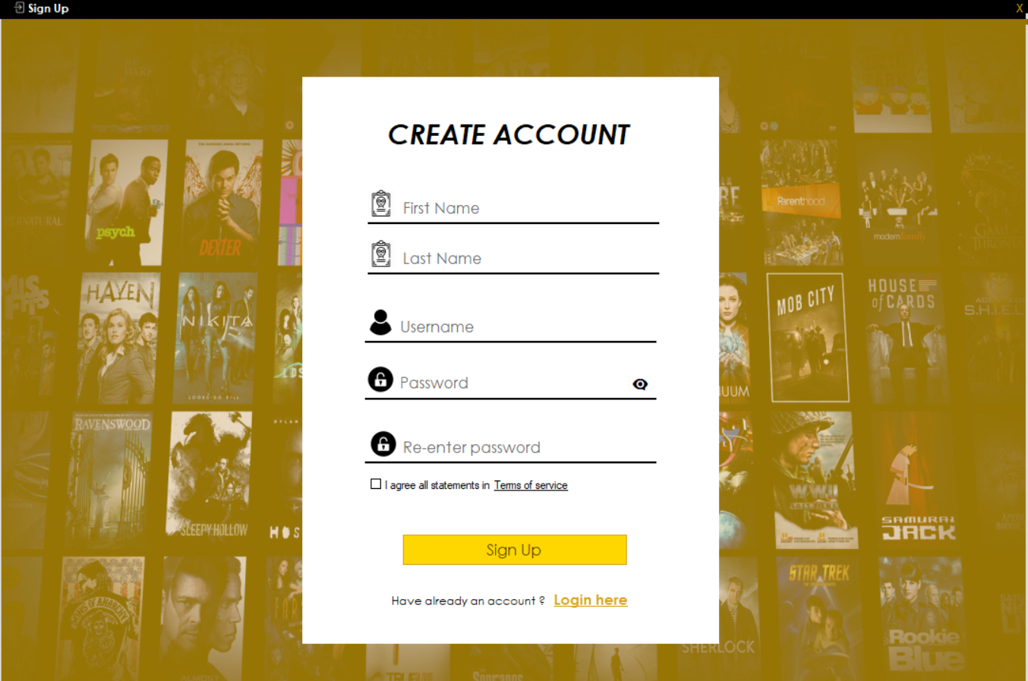
Create Account Page
-First Name field.
-Last Name field.
-Username field.
-Password/New Password fields.
-Hide/Unhide password button.
-Terms of Service box.
-Back to login Link.
-Exceptions(Next Page).

Slide 5
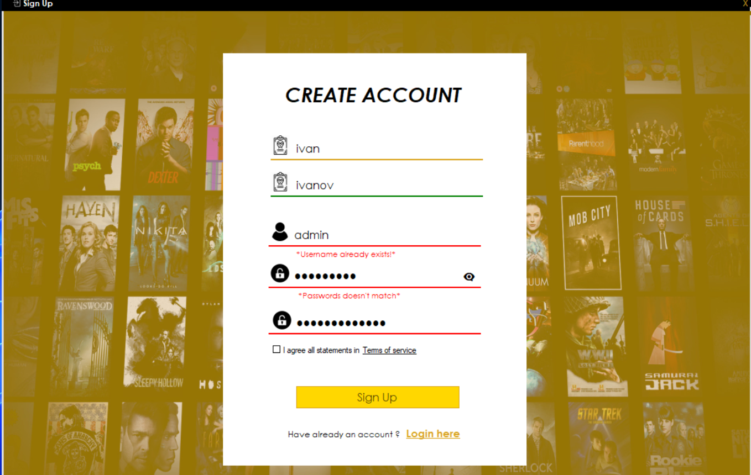
Create Account Exceptions
-Username already exist exception.
-Password doesn’t match.
-Username too long/short exception.
-Password too long /short exception.
-The Fields must not be empty exception.

Slide 6
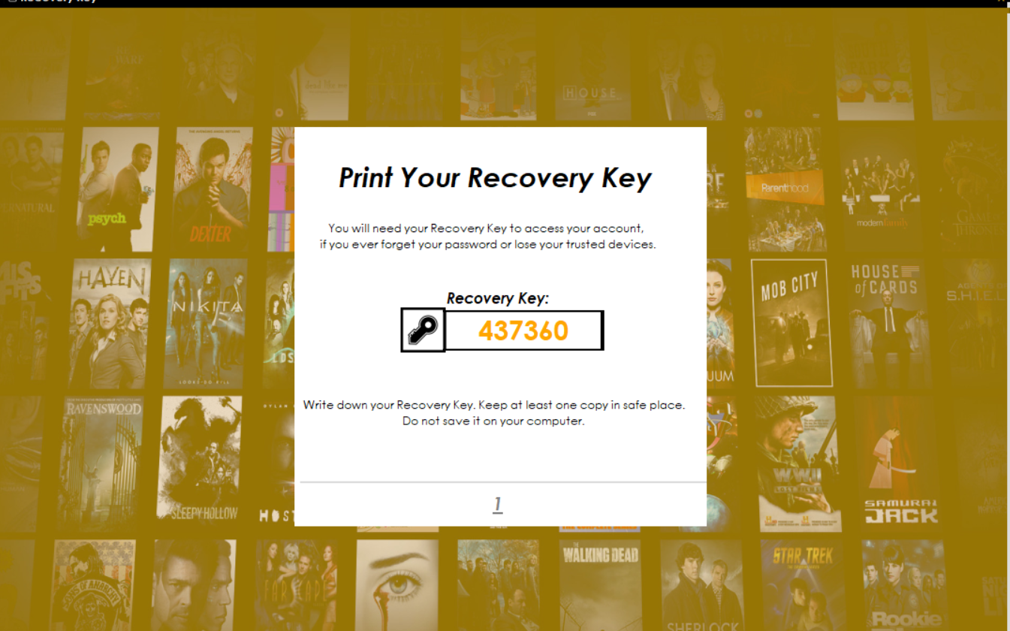
Print Your Recovery Key
-Timer [10-1] -> button Continue.
-Random Unique Recovery Key.
-Information How to store you key, and why you need this recovery key.

Slide 7

Successful created account
-button done, who opens login page.

Slide 8
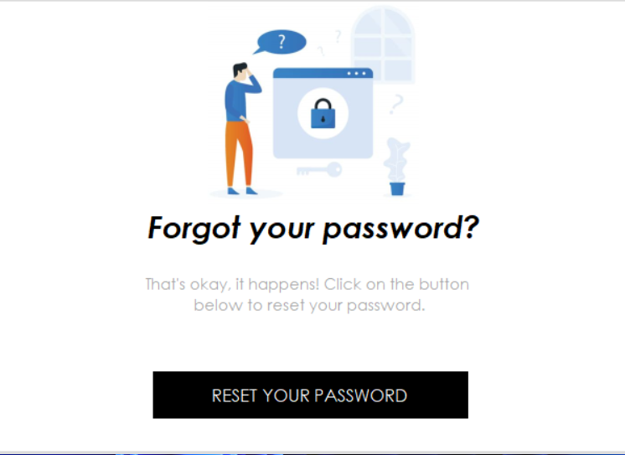
Forgot password
-Back to Login Page.
-Close application.

Slide 9
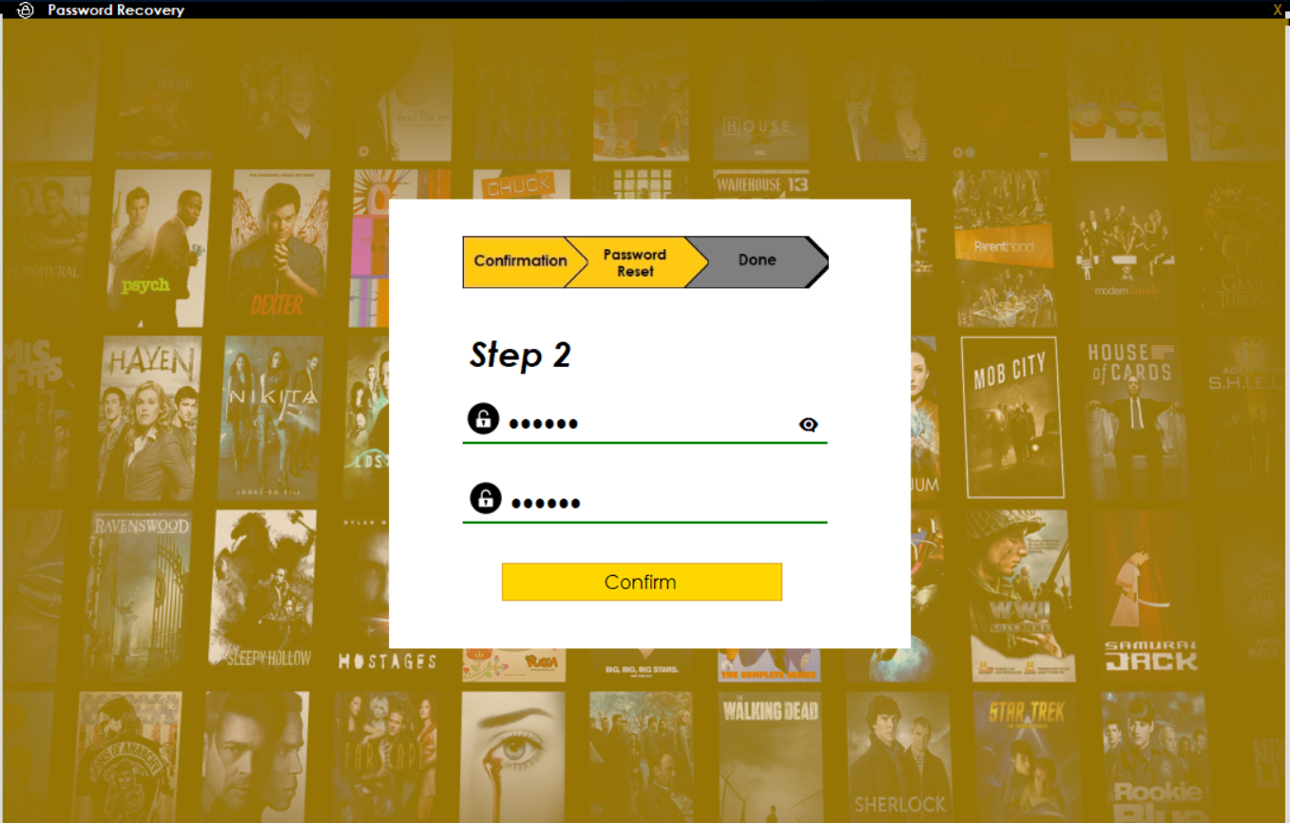
Password reset
-Green Panel if the passwords are same.
-Red If there too short or too long.

Slide 10
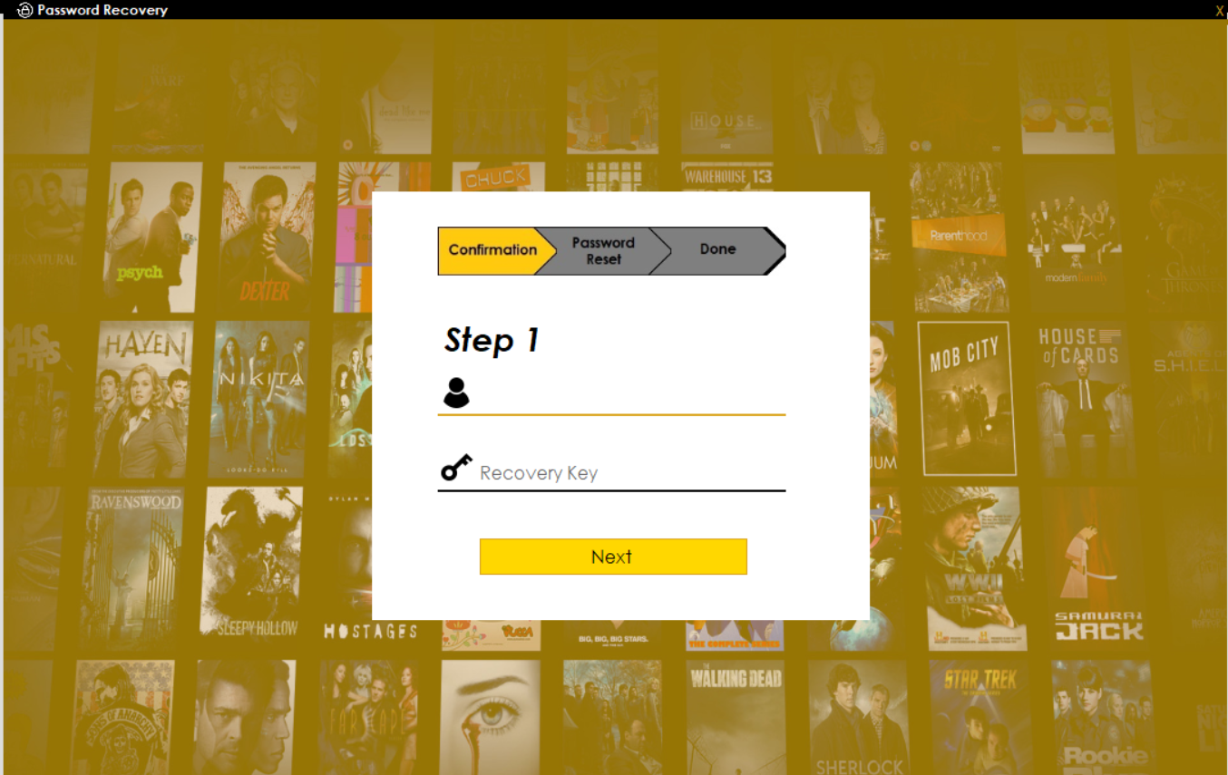
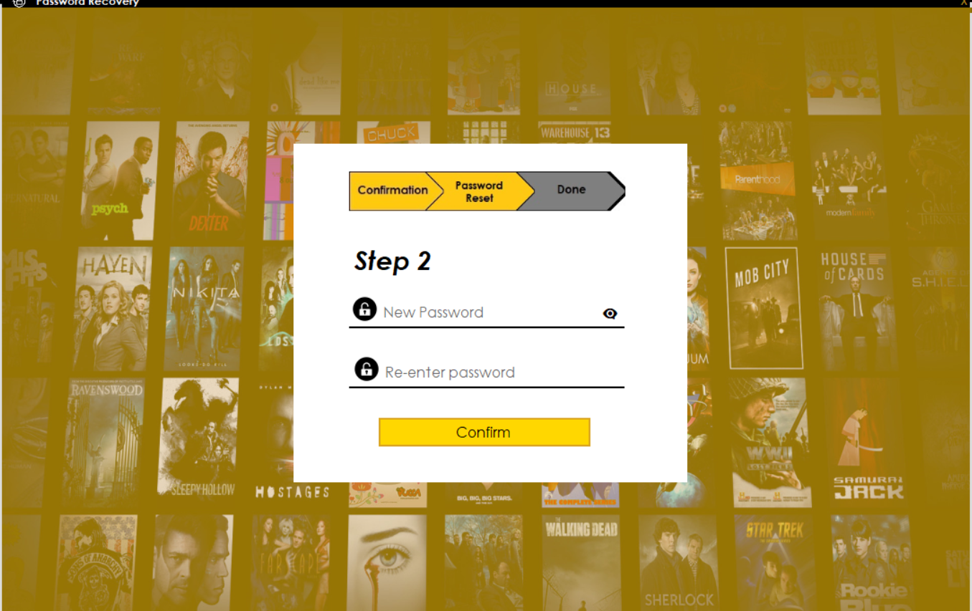
Reset password
-2 Steps.
-Recovery Key.
-Exceptions(Next Page).

Slide 11

Home Page
-Home page button.
-Username label.
-Animated Movies button.
-Animated Add Movie button.
-Animated My List button.
-Logout button.

Slide 12
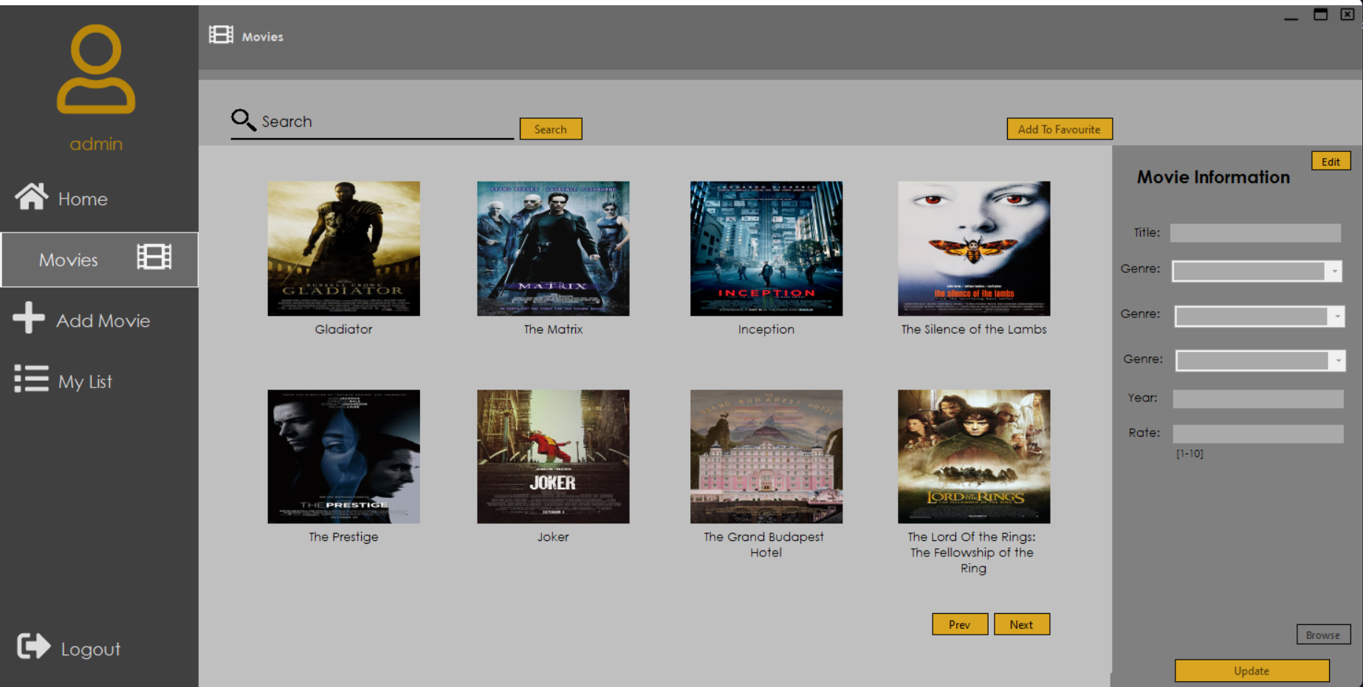
Movies Page
-100+ Movies
-Movie Information Panel
-Search box
-Add to favourite button
- Update fields
-Edit/Lock button
-Next/Prev page

Slide 13
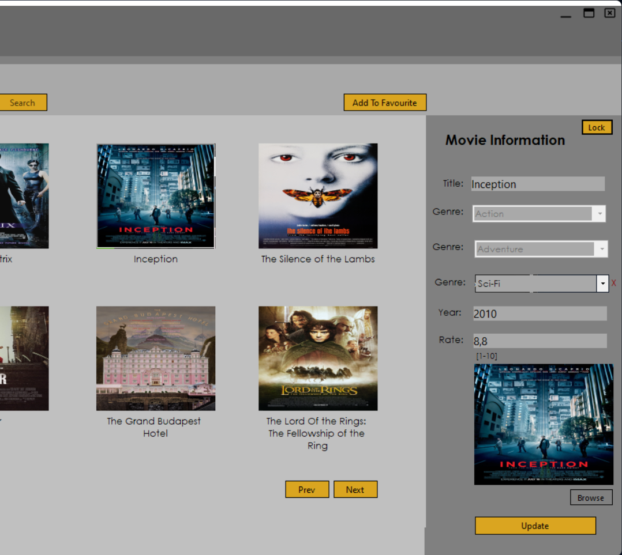
Movie Information
-Gives movie information, and enable fields to be edited

Slide 14
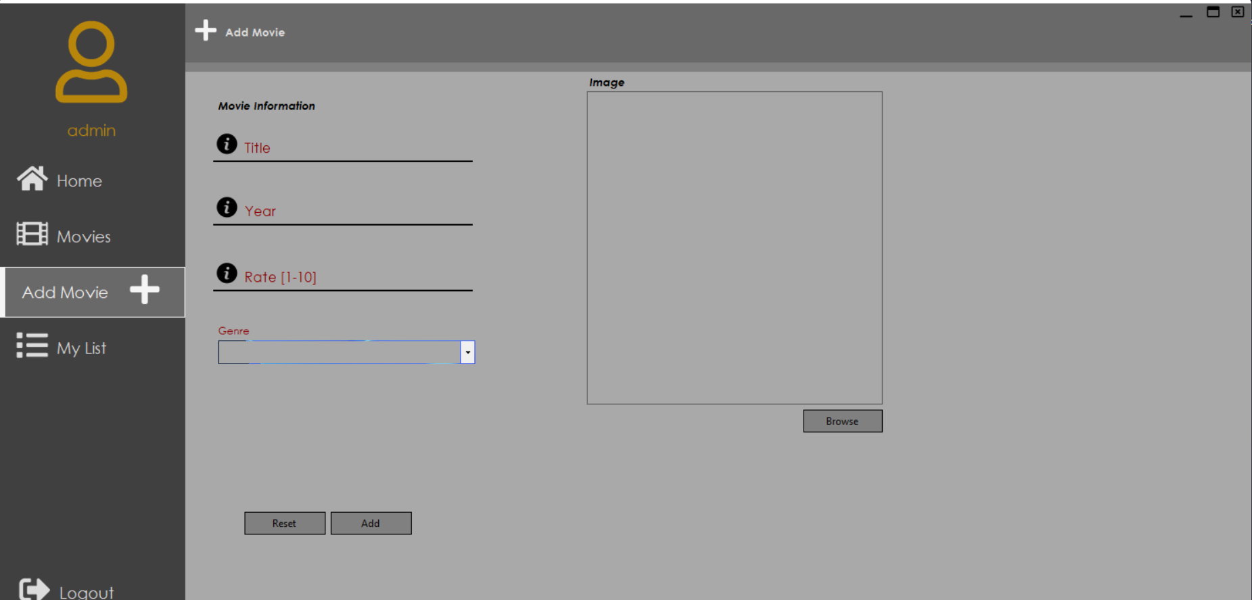
My List Page
-Title field
-Year field
-Rate field
-Genre combo box
-Exceptions(Next Page)
-Add genre button
-Image preview
-Browse image from file

Slide 15
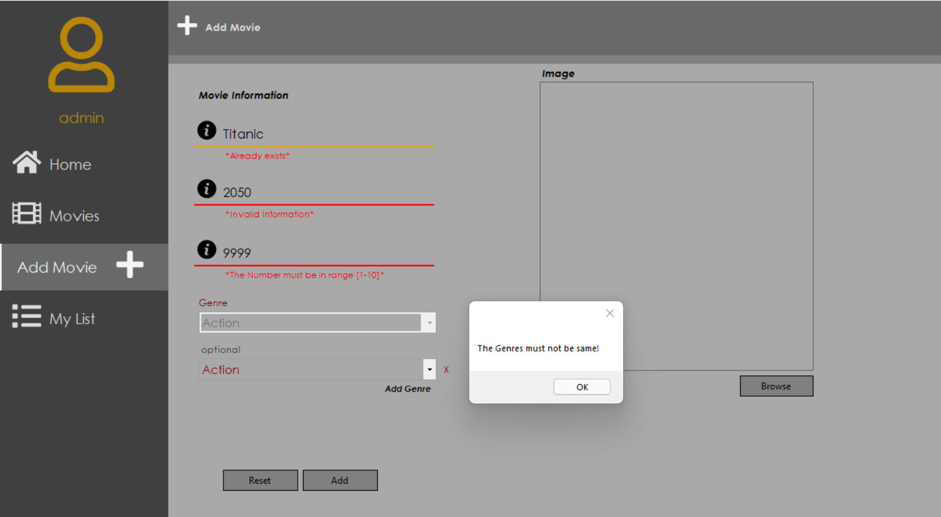
Add Movie Page
-Title already exist exception
-Year – Invalid information exception
-Rate[1-10] – The Number must be in range [1-10] exception
-The Genres must not be same Exception
-The Fields must not be empty exception

Slide 16
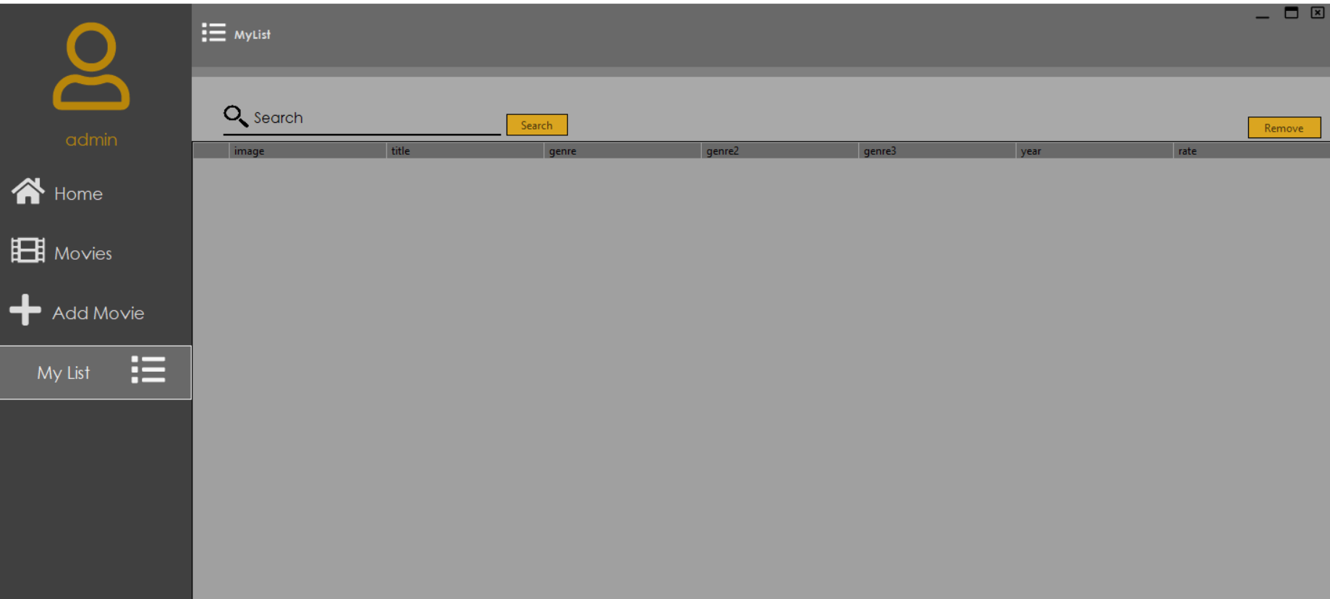
My List Page
-DataGridView
-Search box
-Remove from favourite button

Slide 17


End!
By:
Konstantin Balabanov
Velina Jordanova

